Slide 1
M2W2: Statistical Learning - Probability & Distributions
Agenda:
Recap & Doubt clearance from Applied Stats Week 1: 15-20 mins
Probability – Meaning, concepts with Exercises
Marginal probability – Covid Case Study
Bayes’ theorem – Weather & Spam mail Examples
Probability Distribution and types
Case studies –ATP Tennis, India Earthquake, Business Statistics Exam -
Q&A - ~5 mins
~80 mins
30 mins

Slide 2
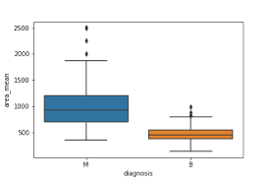
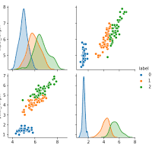
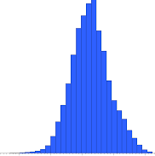
Recap of Applied Stats Week 1 Applied Stats Terms
Quantified results sought for problem
description, solution(s) and business interest
Parameter 1
Parameter 2
….
Hypothesis
“Universe” of data related to problem
Population
Deeper insights thru Hypothesis
Testing, Probability Models,
Regression, classification,
Correlation etc
Predictions
Inferential Statistics
(Probability models,
Hypothesis testing
Regression & Correlation Analysis)
Inference
Generalization
Sampling
of
Population
3Ms – Mean, Median, Mode
Sample (s)
5-Number
Summary
Statistic 1
Statistic 2
……
EDA to draw visual
Insights and statistic
A “finite” and manageable sampling
And representative of Population
Distribution
Central Tendency
Variation
Variance
Std. Dev
Descriptive Statistics

Slide 3
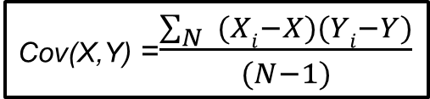
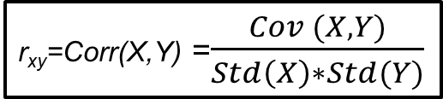
Recap of Applied Stats Week 1 Pearson’s Correlation
Y
Rectangle is 2D
dispersion in data →
Σ Area(Rectangles)
- X
X_{i}
(X_{i}, Y_{i})
Std (Y)
Y
Std_{y}
- X)² / (N-1)
Var =
Σ(X_{i}
Cov (X_{i},Y_{i})
X
Std_{x}
X
X
Std (X)
Std (X)
(X_{i}, X_{i})
X
Variance = Σ_{i} Area(Rectangles) / (N-1)
= Std_{x}²
Cov(X,Y) =$\frac{\sum_{N}{ (Xi−X})(Yi−Y)}{(N−1)}$
X
X
r_{xy}=Corr(X,Y) =$\frac{Cov (X,Y)}{Std\left(X\right)∗Std(Y)}$
Std (X)

Slide 4
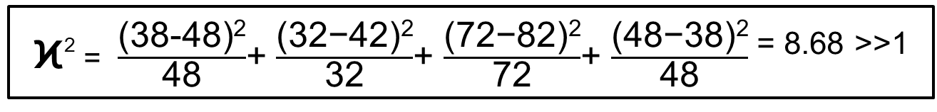
Recap of Applied Stats Week 1 Correlation Analysis – Chi-Square Test
Bivariate Plots –
Categorical-Categorical Variables
Family | Buyer of Car | Non-Buyer of Car | Total
Income per annum < 10L Rs | 38 | 82 | 120
Income per annum >10L Rs | 42 | 38 | 80
Total | 80 | 120 | 200
Correlation
(48)
(72)
(32)
(48)
200 Urban Families
ϰ² = $\frac{\text{(38−48)}\text{2}}{\text{48}}$+ $\frac{\text{(3}\text{2}\text{−4}\text{2}\text{)}\text{2}}{\text{32}}$+ $\frac{\text{(}\text{7}\text{2−}\text{8}\text{2)}\text{2}}{\text{72}}$+ $\frac{\text{(}\text{48}\text{−}\text{38}\text{)}\text{2}}{\text{48}}$ ^{= 8.68 >>1}

Slide 5
Recap of Applied Stats Week 1 Coefficient of Variation, CV
X1
Coefficient of Variation is a measure of relative dispersion
X2
σ2
σ1
CV2 =
>
= CV1
X2
X1
σ2
σ1
Typical goal is to achieve lower CVs with process quality metrics, predictable parameters,
ML model accuracy etc → robustness, lower risk etc

Slide 6









Probability Example
Experiment
Probability of this outcome = P(H) = $\frac{1}{2}$
$$=P(T)$$
Coin Tosses in 4 IPL matches during the weekend
H
H
T
T
Outcome/ a combination of outcomes
M1
M2
M3
M4
Event
HHHH, TTTT, THHH, HTHH, HHTH, HHHT, HHTT, HTHT,
TTHH, THTH, HTTH, THHT, TTTH, HTTT, THTT, TTHT
$$\frac{6}{16}$$
Sample Space
(All possible Outcomes)
$$\frac{4}{16}$$
$$\frac{4}{16}$$
Prob
$$\frac{1}{16}$$
$$\frac{1}{16}$$
C(4,x)*p^{x}*(1-p)^{(4-x)}
{x =0,1,2,3,4}
X→ # of Hs
Coin Toss outcomes for the 4
matches are Independent Events
Coin Toss outcome for a match is Mutually Exclusive
Possible
Values of
Event
All
Hs
3Hs
1T
2H
2T
3Ts
1H
All
Ts
Probability Distribution Binomial Type

Slide 7
Probability – Meaning & Concepts
Probability refers to chance or likelihood of a particular event-taking place.
An event is an outcome of an experiment.
An experiment is a process that is performed to understand and observe possible outcomes.
Set of all outcomes of an experiment is called the sample space.

Slide 8
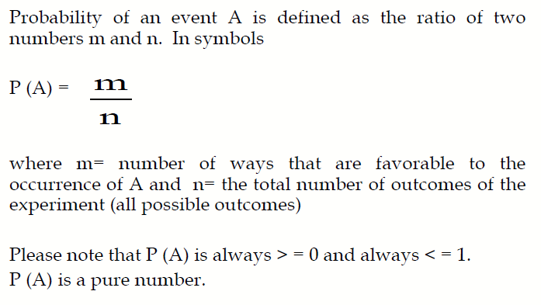
Definition of Probability

Slide 9
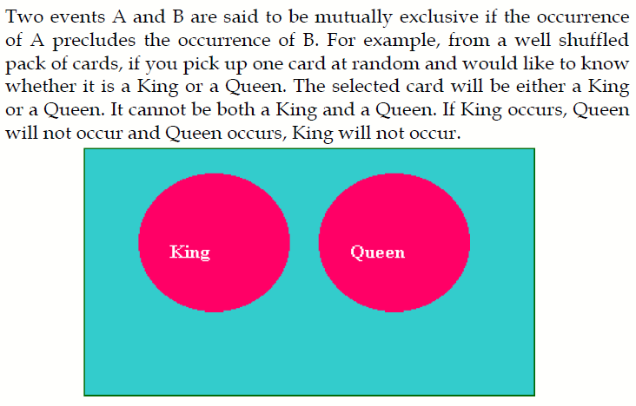

Mutually Exclusive Events
1
2
3
4
5
6

Slide 10
Independent Events
Two events A and B are said to be independent if the occurrence of A is in no way influenced by the occurrence of B. Likewise occurrence of B is in no way influenced by the occurrence of A.
Example → Result of Consecutive tosses of a coin are independent events

Slide 11
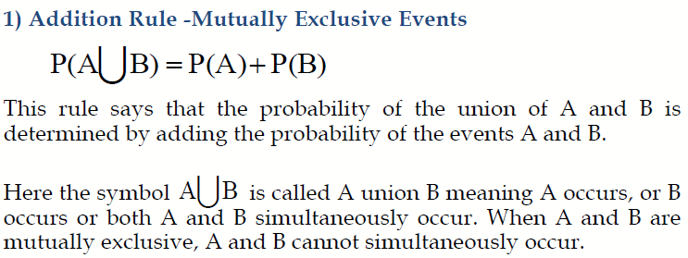
Rules for Computing Probability

Slide 12
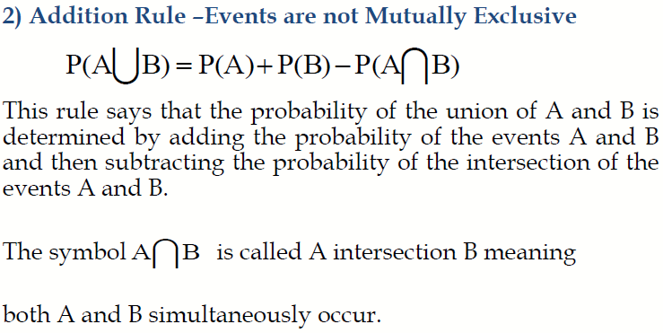
Rules for Computing Probability

Slide 13



Venn diagrams
K
Q
K
Sp
K$∩$Sp
Mutually exclusive
P(K $∩$ Q) = 0
Not Mutually exclusive
What is the chance that the drawn card from a deck is a K or Spade?

Slide 14
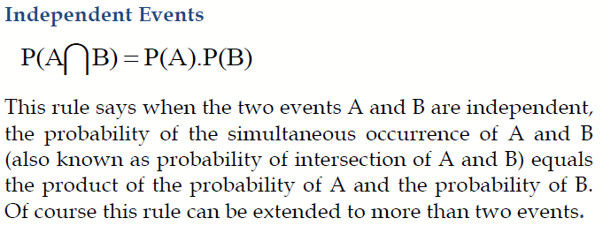
Multiplication Rule

Slide 15
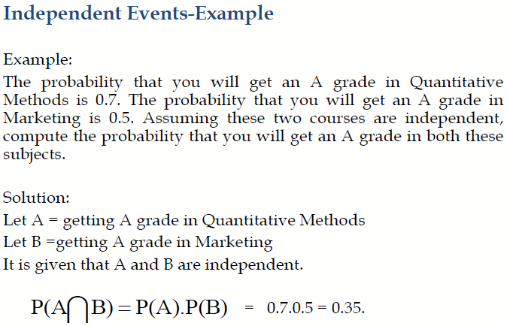
Multiplication Rule

Slide 16
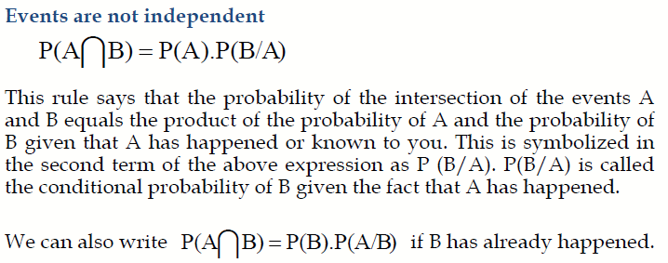
Multiplication Rule

Slide 17
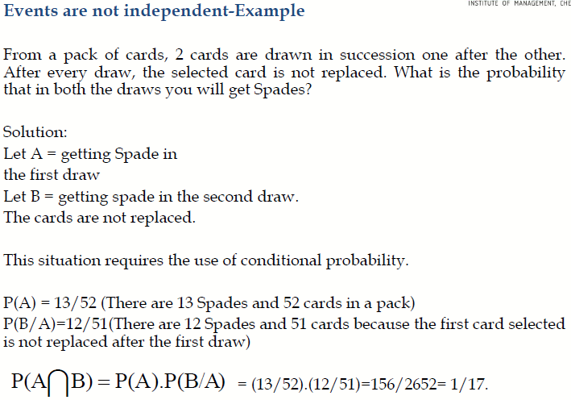
Multiplication Rule

Slide 18
Marginal Probability
Contingency table consists of rows and columns of two attributes at different levels with frequencies or numbers in each of the cells. It is a matrix of frequencies assigned to rows and columns.
The term marginal is used to indicate that the probabilities are calculated using a contingency table (also called joint probability table).

Slide 19
Exercise 2 for Marginal & Conditional Probability
1. What is the probability that a randomly tested Indian from KA will test +ve? (Positivity rate in KA)
Compare the positivity rate of KA with MH and India overall.
2. What is the probability that a randomly tested Indian will test positive and die? (Crude death rate (per 1000) in India?)
3. What is the probability that a randomly tested Indian will be Covid +ve and from MH?
(Significance of MH in India Covid context)
4. What is the probability that a Covid +ve patient from MH or KA will die? (Case fatality rate in MH & KA together)
5. What is the probability that a dead Covid patient is from KA or MH? (% of deaths from KA & MH together)

Slide 20
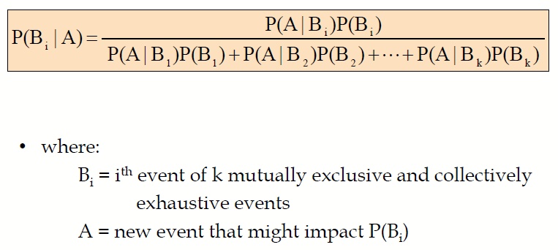
Bayes’ Theorem

Slide 21
Simple Example of Bayes’ theorem What kind of a day is it?
Any Day! annually
A Day can either be Sunny or Cloudy.
But it can Rain in either condition.
R = Raining, P(R) + P(Ř) = 1,
What type of day is it?
D = Either Sunny or Cloudy Day(can’t be both)
S = Sunny Day
C = Cloudy Day
Sunny
Rainy
Cloudy

Slide 22
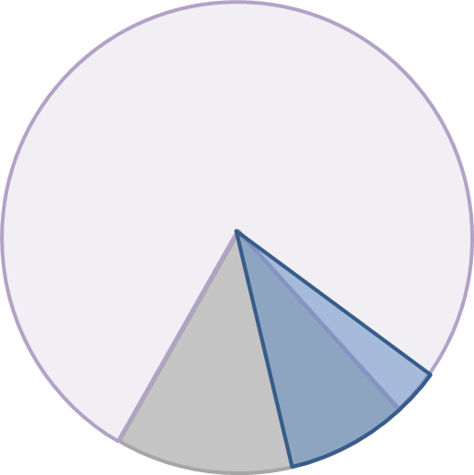
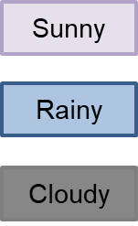

Simple Example of Bayes’ theorem
P(Raining) = P(Raining|Sunny Day)*P(Sunny Day) + P(Raining|Cloudy day)* P(Cloudy day)
P(Raining ∩ Sunny) = P( Sunny ∩ Rainy)
P(Raining|Sunny)*P(Sunny) = P(Sunny|Raining)*P(Raining)
So,
P(R)=P(R|S)*P(S)+P(A|C)*P(C) &
P(R|S)*P(S) = P(S|R)*P(R) ➔ P(S|R) = P(R|S)*P(S)/ P(R)
Therefore, P(S|R) = P(R|S)*P(S) / {P(R|S)*P(S)+P(R|C)*P(C)} → Bayes’ theorem
P(S|R) = P(Sunny | Raining)

Slide 23
Geometric Visualization of Bayes’ theorem
S
R
R1
S
R2
C
=
x
+
x
D
S
D
D
R
C
C C
R1
?
R2
R1
R1
R
S
R
R1
R2
x
x
=
S
D
R
D
=
+

Slide 24
Bayes’ Theorem

Slide 25

Bayes’ Theorem Practical Example
P(“An Email is Spam”)?
P(Spam|Words) = $\frac{\text{P}\text{(}\text{Words}\text{|}\text{Spam}\text{) *}\text{P}\text{(}\text{Spam}\text{)} }{\text{P}\text{(}\text{Words}\text{)}}$
Proportion of Spam
from historical email data
Spam classification
of words
Dictionary, NLP

Slide 26
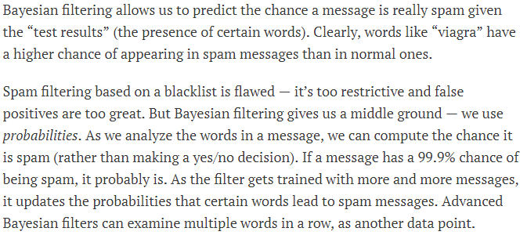
Bayes’ Theorem Practical Example
P(“An Email is Spam”)?

Slide 27
Probability Distribution?
In precise terms, a probability distribution is a total listing of the various values the random variable can take along with the corresponding probability of each value. A real life example could be the pattern of distribution of the machine breakdowns in a manufacturing unit.
The random variable in this example would be the various values the machine breakdowns could assume.
The probability corresponding to each value of the breakdown is the relative frequency of occurrence of the breakdown.
The probability distribution for this example is constructed by the actual breakdown pattern observed over a period of time. Statisticians use the term “observed distribution” of breakdowns.

Slide 28
Binomial Distribution
The Binomial Distribution is a widely used probability distribution of a discrete random variable.
It plays a major role in quality control and quality assurance function. Manufacturing units do use the binomial distribution for defective analysis.
Reducing the number of defectives using the proportion defective control chart (p chart) is an accepted practice in manufacturing organizations.
Binomial distribution is also being used in service organizations like banks, and insurance corporations to get an idea of the proportion customers who are satisfied with the service quality.

Slide 29
Conditions for Applying Binomial Distribution (Bernoulli Process)
Trials are independent and random.
There are fixed number of trials (n trials).
There are only two outcomes of the trial designated as success or failure.
The probability of success is uniform through out the n trials

Slide 30
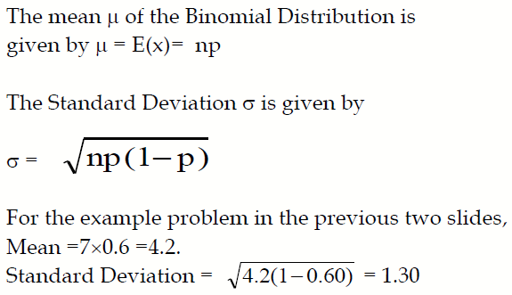
Mean and Standard Deviation of the Binomial Distribution

Slide 31
Poisson Distribution
Poisson Distribution is another discrete distribution which also plays a major role in quality control in the context of reducing the number of defects per standard unit.
Examples include number of defects per item, number of defects per transformer produced, number of defects per 100 m2 of cloth, etc.
Other examples would include 1) The number of cars arriving at a highway check post per hour; 2) The number of customers visiting a bank per hour during peak business period; 3) The number of pixels in the image that are corrupted.

Slide 32
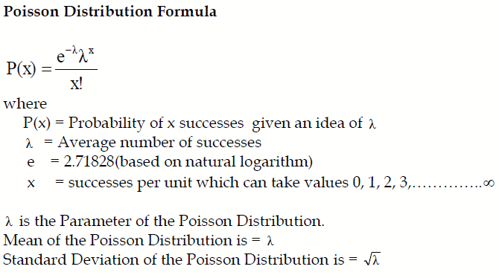
Poisson Probability Function

Slide 33
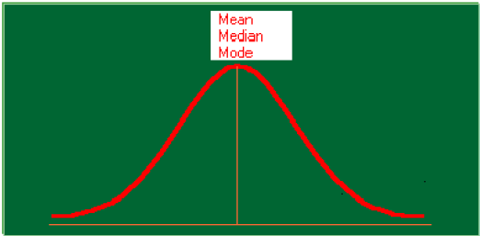
Normal Distribution

Slide 34
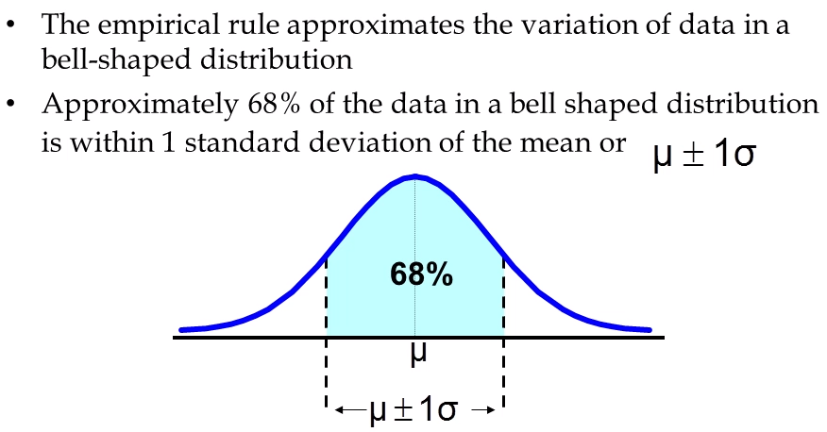
Normal Distribution

Slide 35
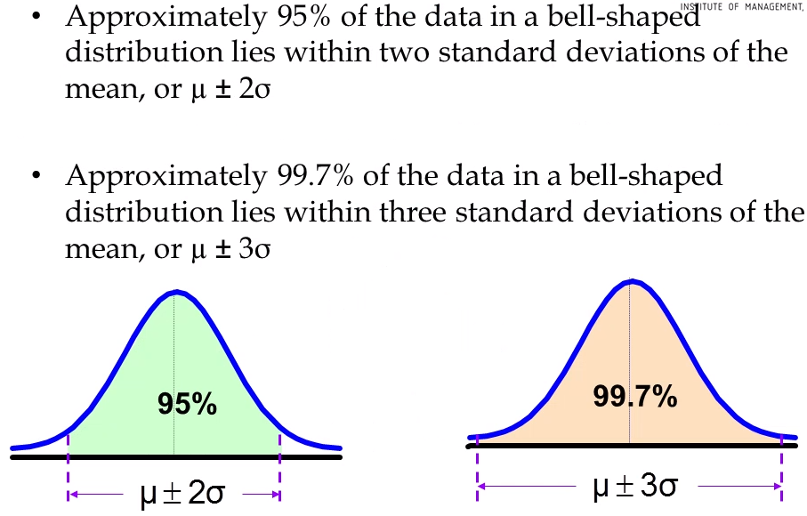
Normal Distribution

Slide 36
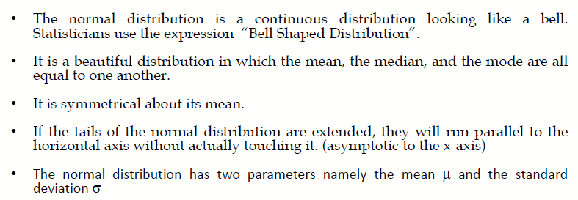
Properties of Normal Distribution

Slide 37
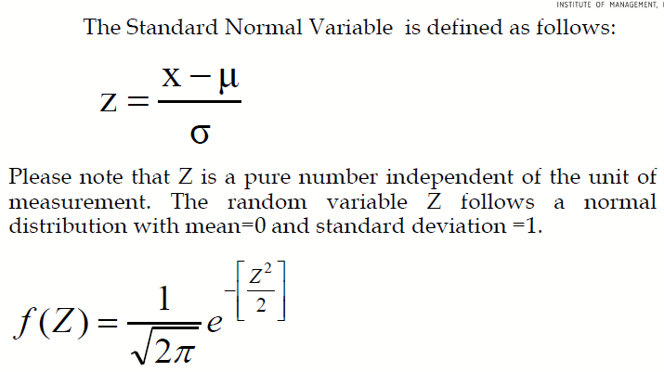
Standard Normal Distribution

Slide 38
Practice Exercises and Case Studies

Slide 39
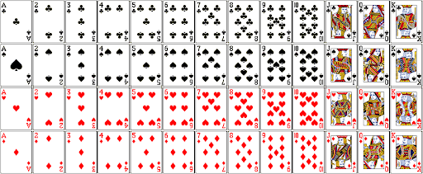

Exercise 1 for Conditional Probability & Multiplication Rule
Use P(A∩B)
or
P(AUB)
Identify the type of events and evaluate,
What is the probability that when the 2 identical dice are rolled together, the number you get as a sum of the numbers
on the 2 dice-
a. Is an even number?
b. You get a total of 10?, 7?
c. Of getting 2 odd numbers?
Can you construct the probability distribution for the all the outcomes (Sample space) considering the sum of numbers of the 2 dice?
When you draw 2 cards from a deck of 52 cards, one after the other without replacing, the probability of getting
i. 2 consecutive diamonds?
ii. An Ace and a Diamond considering both draws?
iii. A King and a Queen considering both draws?

Slide 40

Bayes Theorem – Exercise 2
Bayes theorem
P(A|B), reads “A given B,” represents the probability of A if B was known to have occurred.
In many situations we would like to understand the relation between P(A|B) and P(B|A).
Practice Exercise
You are planning an outdoor event tomorrow. When it actually rains, the weatherman correctly forecasts rain 90% of the time. When it doesn't rain, he incorrectly forecasts rain 10% of the time. Historically it has rained only 5 days each year. Unfortunately, the weatherman has predicted rain for tomorrow. What is the probability that it will rain tomorrow?
HINT:
P(F|R) = 0.9
P(F|Ř ) = 0.1
P(R)=5/365

Slide 41
Exercise 3 for Binomial Distribution
A bank issues credit cards to customers under the scheme of Master Card. Based on the past data, the bank has found out that 60% of all accounts pay on time following the bill. If a sample of 7 accounts is selected at random from the current database, construct the Binomial Probability Distribution of accounts paying on time.

Slide 42
Exercise 4 – Poisson Distribution
If on an average, 6 customers arrive every two minutes at a bank during the busy hours of working, a) what is the probability that exactly four customers arrive in a given minute? b) What is the probability that more than three customers will arrive in a given minute?

Slide 43
Exercise 5 - Normal distribution
At the Conclusion of a course in business statistics, a group of management students sat for a written examination. The results throw up the following information.
Marks obtained have a mean of 60 and a standard deviation of 12. There were 300 students who wrote the exam. The pattern of marks follows a normal distribution
What is the percentage of students who score more than 80
What is the percentage of students who score less than 50
What should be the distinction mark if the highest 10% of students are to be awarded distinction? Graphical method can be used for convenience.
How many students score between 36 and 84 marks
(See solution hints in next slide after 1st trying to solve using stats.norm.cdf() and using Zscore table for (c) )

Slide 44
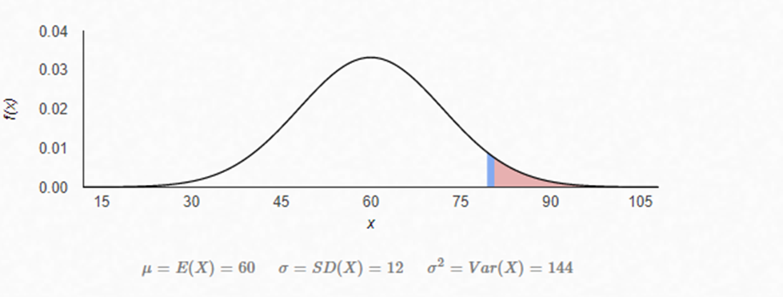
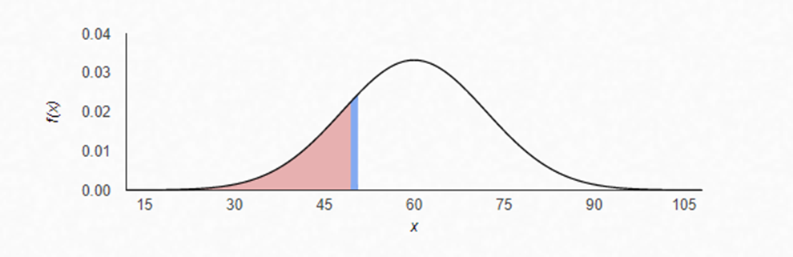
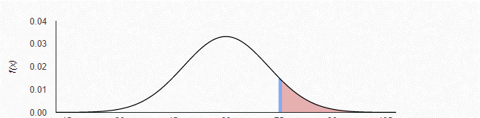
Solution hints for Exercise 5 (Normal distribution)
a
1-stats.norm.cdf(1.67)
0.0474
b
stats.norm.cdf(-.833)
0.2024
c
0.9
0.1

Slide 45
Case Studies – Mentor’s Selections
Binomial Distribution – ATP Tennis Tournaments data, Wendy’s Fast-Food Restaurant Data
Poisson Distribution – 50 year Indian Earthquake data, Insurance Salesmen data
Case study on Business Statistics Course based on Poisson and Normal Distribution (same as Exercise 5)

Slide 46
More Useful Links for Applied Stats
Poisson Distribution
https://towardsdatascience.com/the-poisson-distribution-103abfddc312
Poisson distribution in R and Python
https://towardsdatascience.com/the-poisson-distribution-and-poisson-process-explained-4e2cb17d459
Normal Distribution with Python
https://towardsdatascience.com/understanding-the-normal-distribution-with-python-e70bb855b027
Gaussian Distribution in Data Science and Machine Learning
https://medium.com/ai-techsystems/gaussian-distribution-why-is-it-important-in-data-science-and-machine-learning-9adbe0e5f8ac
Hypothesis Testing
https://machinelearningmastery.com/statistical-hypothesis-tests/
https://towardsdatascience.com/understanding-the-normal-distribution-with-python-e70bb855b027
https://www.tutorialspoint.com/python_data_science/python_normal_distribution.htm

Slide 47


Questions?

